Slide 1
Creating a workplace where PWDs want to work
SHERI BYRNE-HABER
Senior Staff Accessibility Architect

Slide 2
Why accessible recruiting is important
Being inclusive is part of most organization’s values.
You don’t want a knock on the door from the EEOC.
Companies that are disability champions are 4X as likely to outperform their peers, with increased innovation and higher ROI.
1/3 of managers say people with disabilities are more loyal and
Millennials – currently 35 % of the workforce
  67 % of millennials strongly consider diversity when deciding where to accept employment offers.
  20 % of millennials said they decided not to apply for a job because there wasn’t enough evidence of neurodiversity inclusion.
  80 % of millennials said they would be more likely to apply for a job where they saw neurodiversity inclusion, even if they didn’t identify as neurodiverse

Slide 3
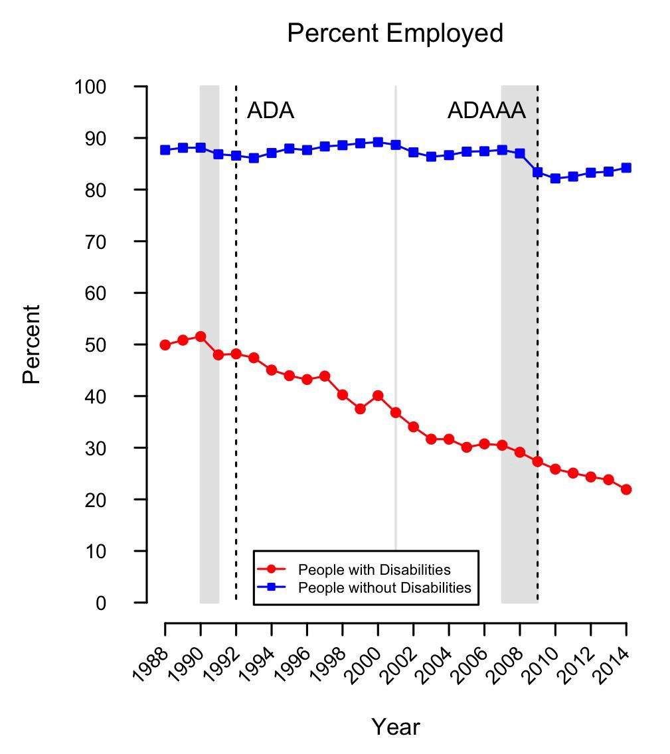
History of employment of people with disabilities
Notes:
Global Disability Inclusion showed that 51% of people with a disability have either been laid off, furloughed, or believe they will lose their job in the next 90 days compared to 28% of those without a disability.
20 % of people with disabilities have lost (not just fear losing) their jobs or been furloughed

Slide 4






AGENDA
Step-1
Step-2
Step-3
Step-4
Step-5
Step-6
Research
Application
Interview(s)
Offer
Onboarding
Retention

Slide 5

ORGANIZATIONAL RESEARCH

Slide 6


ORGANIZATIONAL RESEARCH Details
No ablest requirements in the job descriptions
Job boards should be accessible.
The organizational website should be accessible.
Notes:
Researching a company is often the first step in a job application process. It’s how people figure out that this is a company they want to work for, and also help people craft their cover letters. To provide equal access:

Slide 7

APPLICATION

Slide 8

APPLICATION Details
The entire job application submission process must be accessible.
Any tests or evaluations used by the organization must be accessible
Is your process compliant for people who use assistive technology, or is it straightforward and easy?
Is your applicant tracking system biased against people with disabilities?

Slide 9

INTERVIEW(S)

Slide 10



INTERVIEW(S) Details
must be physically or digitally accessible, including providing captioning or interpreters if requested.
Interviewers must receive training on unconscious bias and interviewing people with disabilities. You don’t always get firm handshakes and eye contact when you are interviewing people with disabilities. That doesn’t mean they can’t do the job.
The candidate should be able to EASILY and PAINLESSLY request an interview/job accommodation at any time in the process without FEAR OF RETRIBUTION.
There should be multiple channels using different modalities (i.e., both keyboard-driven such as chat/email + voice) to reach out to TA or HR.

Slide 11

OFFER

Slide 12


OFFER Details
The offer stage seems to feel like death by 1000 PDF files sometimes.
If those PDFs are inaccessible, how will the candidates understand their benefits or provide anything that has to be signed?
If third-party vendors are doing background checks, their processes need to be accessible too.
Benefits, 401K plan enrollment, health insurance, I-9 — it ALL must be accessible.

Slide 13

ONBOARDING

Slide 14

ONBOARDING Details
If you have not onboarded someone with a particular type of disability before, take a very critical eye and walk through your onboarding process step by step

Slide 15






Potential onboarding accessibility issues …
Machine Image
Buddy System
Software Catalog
Training
Videos – Captioned AND Audio Described
Internal Communications

Slide 16
Retention

Slide 17



What programs do you have to keep employees?
How easy is it to get reasonable accommodations
Is everything your organization buys, uses, and builds accessible?
Are internal employee development programs accessible to employees with disabilities and do they participate at an equal rate?
Are your organization’s events, facilities, and support systems accessible

Slide 18
What support are you providing your employees with disabilities?
Employee Resource Groups
Self-ID campaigns
Mental Wellness / Stress reduction programs
Flexible schedules / full WFH options without having to go through an accommodations process
Talk circles
Grievance process
Not tokenizing or expecting PwDs to volunteer for all disability related projects

Slide 19
TL;DR
Disability needs to be considered throughout the entire employee lifecycle
Disability needs to be considered in all departments
Disability needs to be a normalized experience

Slide 20


THANK YOU
SHERI BYRNE-HABER
sbyrnehaber@vmware.com
https://medium.com/@sheribyrnehaber
https://www.linkedin.com/in/sheribyrnehaber/

