Slide 1
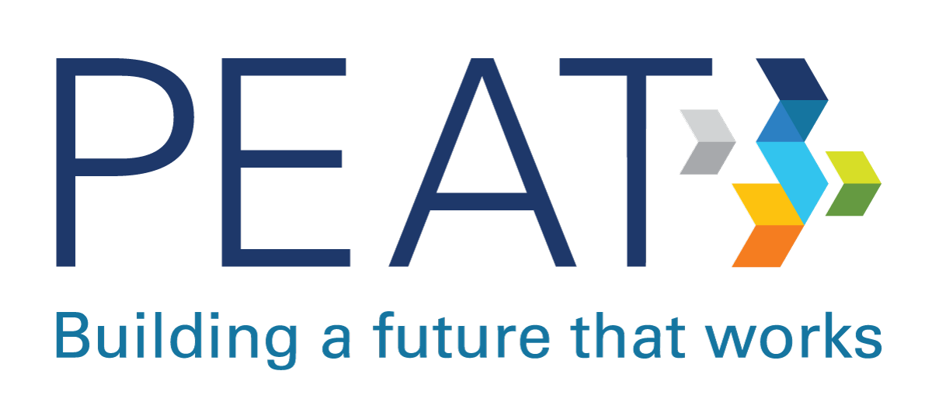

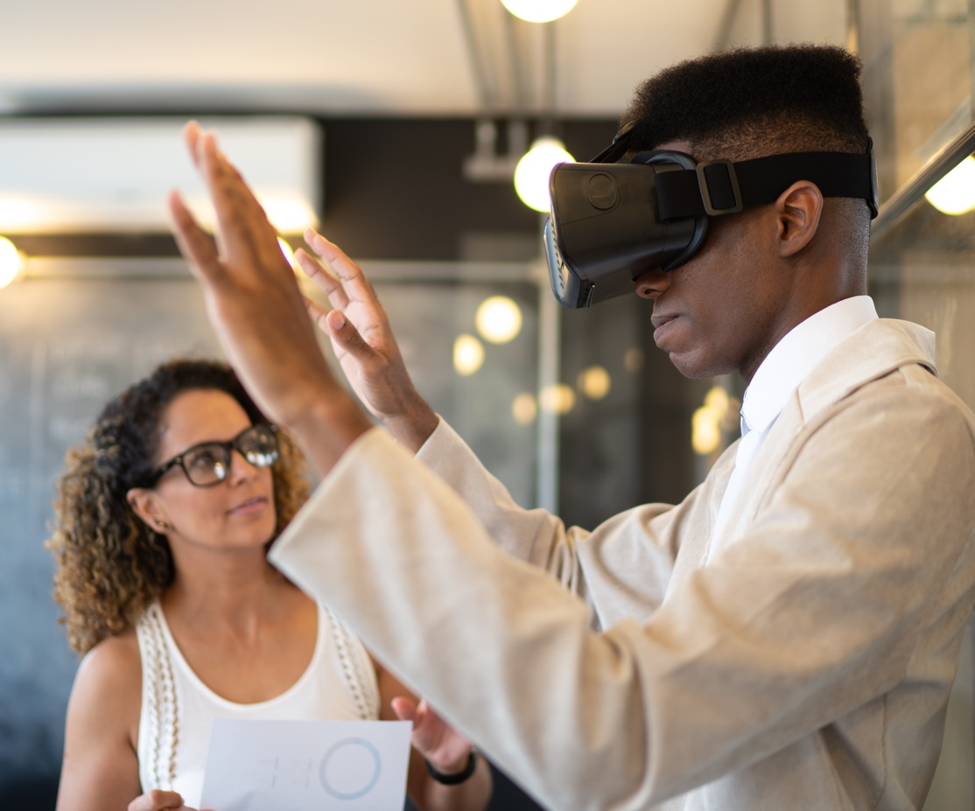
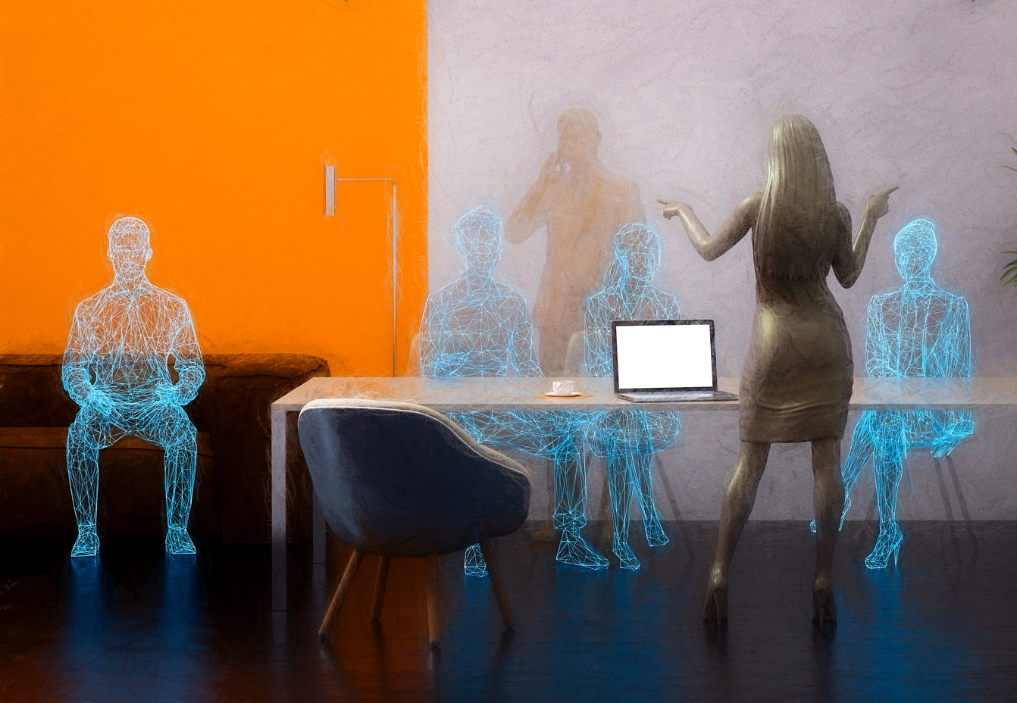

Brave New World: Accessible Immersive Technologies and the Future of Work
Bill Curtis-Davidson
October 2021

Slide 2

Hi, I’m Bill Curtis-Davidson
Senior Consultant – Inclusion & Accessibility and AI Integration Lead, Wheelhouse Group
Co-Director, Partnership on Employment &
Accessible Technology (PEAT)
Former Roles: Magic Leap Accessibility, Level Access, IBM Accessibility, and Georgia Tech
Learn More about PEAT: PEATworks.org
Notes:
PEAT is funded by the U.S. Department of Labor’s
Office of Disability Employment Policy (ODEP)
We foster collaborations that make emerging technologies accessible. To support workplaces in using inclusive technologies that engage the skills of employees with disabilities. To build a future that works.

Slide 3

Topics We’ll Explore
How immersive technologies are reshaping work
New ways to engage, train, connect the hybrid workforce
Gaining a competitive edge with accessible immersive tech
Community efforts to improve immersive tech accessibility
How organizations can prepare for this “brave new world”
Resources and Q&A
The content for this session is based off a newly-published White Paper, “Inclusive XR in the Workplace”, which PEAT has co-authored with the XR Association. Learn more at: PEATworks.org/ or XRA.org/
Notes:
Extended Reality (XR) and immersive technologies are poised to reshape how businesses work.
XR is being used to engage employees / customers in new ways, improve job training, and enhance hybrid workplace collaboration.
Organizations that prioritize accessibility in XR technologies they adopt can gain a competitive edge in a tight labor market.
A growing community is working to help ensure XR technologies are “born accessible” so people with disabilities can fully participate.
Organizations should get involved to shape this brave new world!

Slide 4

Important Notes
PEAT material does not necessarily reflect the views or policies of the Office of Disability Employment Policy, U.S. Department of Labor
Nor does the mention of trade names, commercial products, or organizations imply endorsement by the U.S. Government
Examples of specific technologies shown in this session are for illustration purposes only

Slide 5
Immersive Technologies Are Reshaping How We Work
Brave New World

Slide 6
What is immersive technology?
Immersive technology is an integration of virtual content with the physical environment in a way that allows the user to engage naturally with the blended reality.
In an immersive experience, the user accepts virtual elements of their environment as part of the whole, potentially becoming less conscious that those elements are not part of physical reality.
Reference: TechTarget, WhatIs.com, “Immersive Technology”

Slide 7



Immersive Tech and XR
Immersive technology is synonymous with “Extended Reality” or “XR”, and there are three key types or XR technologies and experiences
Virtual Reality
Replaces a user’s
real surroundings with
a simulated environment,
such as a construction site, a subway system, a coastal flood plain, or an energy grid.
Augmented Reality
Layers computer-generated imagery onto a user’s view of
the real world, thus
providing a composite view.
Mixed Reality
Blends augmented and
virtual reality, allowing
users to experience simulated content within their physical worlds and to manipulate and interact with virtual elements in real time.

Slide 8
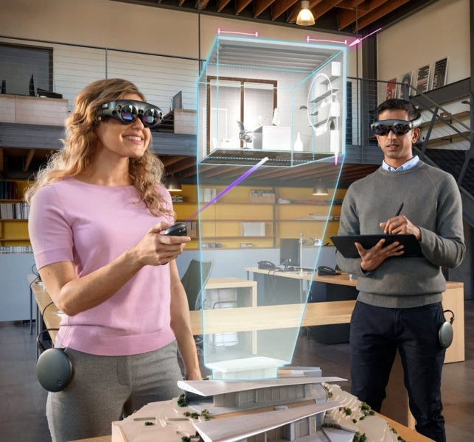
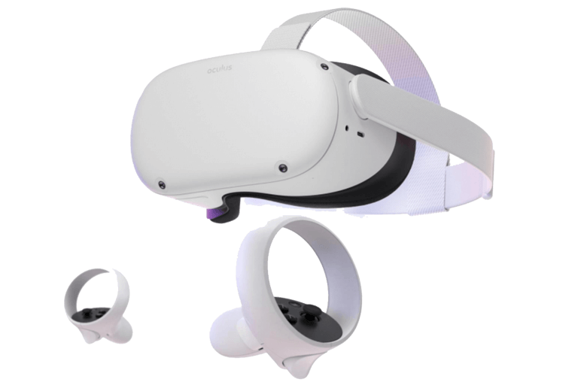
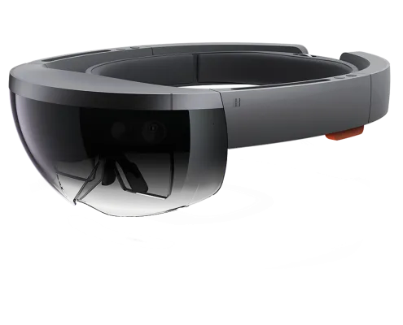
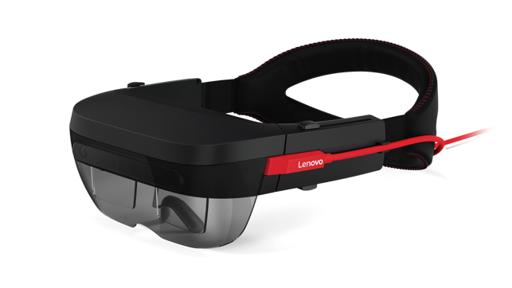
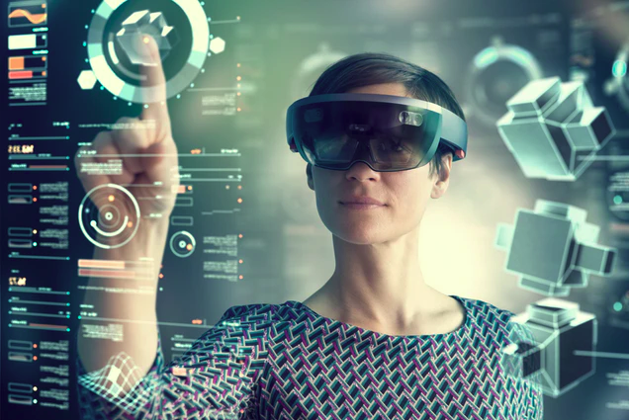
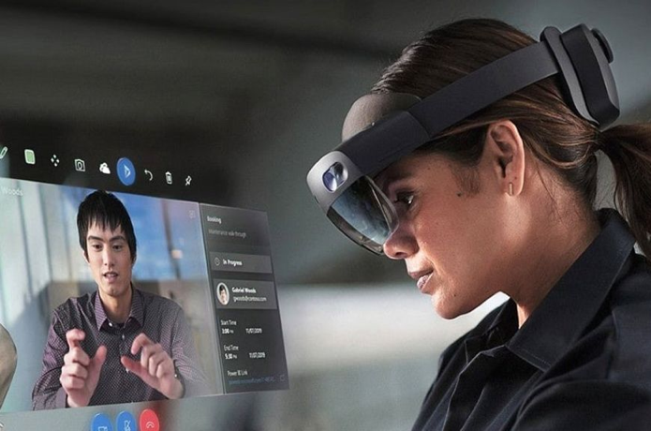
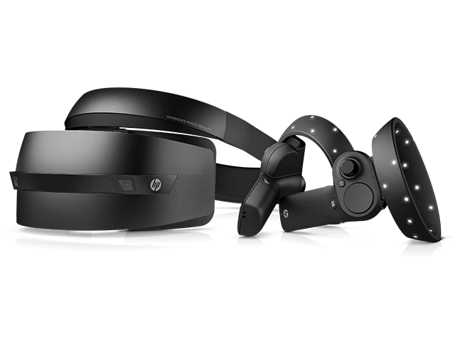
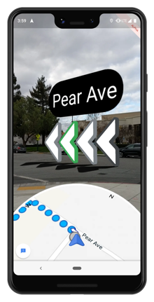
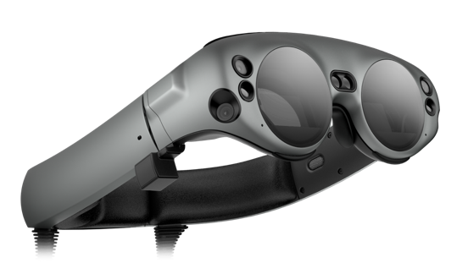
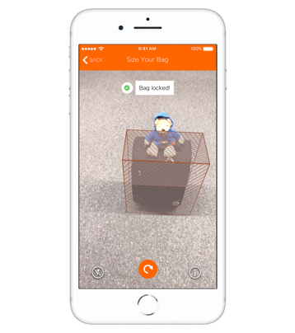
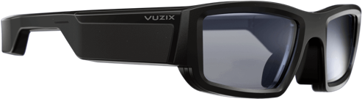
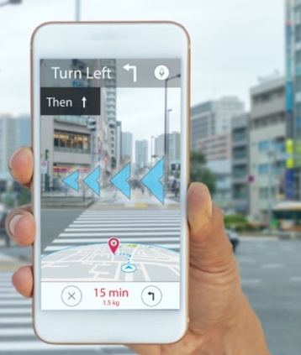
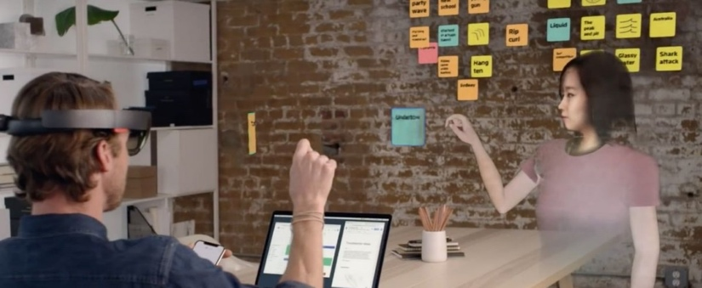
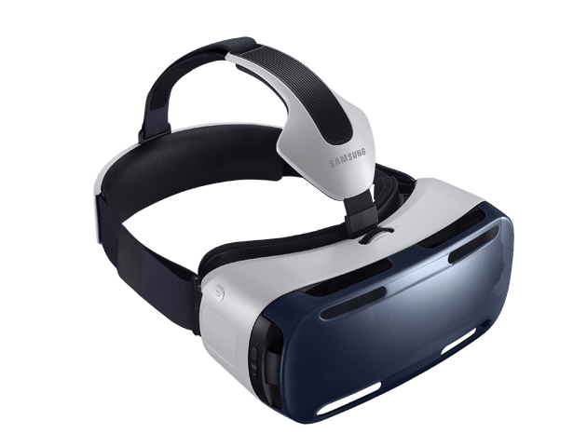
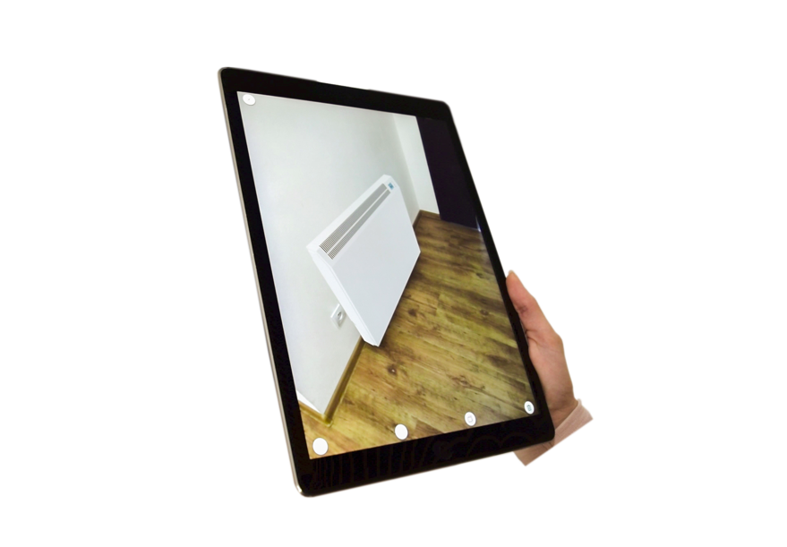
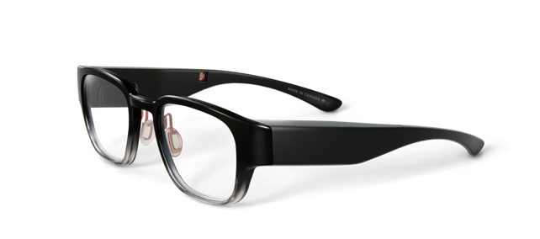
XR is a New Computing Paradigm
Not just for gaming, but for many serious uses like training, communication, and collaboration. More important as we recover in 2021 and beyond.
Explosion of devices, including HW, wearables, platform SW, accessories, and developer tools. Often devices connect with “flat screen” devices and browsers.
Convergence of tech such as AI, computer vision, IoT - and 5G - will burst XR’s potential and adoption… connecting physical and digital people, places and things.
Images: Apple, Facebook/Oculus, Google/North, HP, Lenovo, Magic Leap, Microsoft, Sony, Spatial, LED Magazine

Slide 9
XR is Reshaping Fast-Growth Jobs
As we recover from the COVID-19 pandemic, XR is being rapidly adopted in industries that have some of the fastest-growing jobs in the U.S.
Uses of XR include warehousing and inventory management, product engineering and design, immersive job training and upskilling, and virtual healthcare patient monitoring.
Both current and future employees will start to see expanding access to immersive technologies at work.

Slide 10
Recovery Collaboration Challenges
A recent study found the recent massive shift to remote work created new challenges (data from Microsoft):
  Collaboration to be more siloed and less interconnected
  Synchronous communication to be decreased
  More difficulty for employees to acquire and share new information across the network
Immersive tech could likely play a key role in addressing these challenges by helping connect the hybrid workforce.
Reference: Yang, L., Holtz, D., Jaffe, S. et al. The effects of remote work on collaboration among information workers. Nat Hum Behav (2021). https://doi.org/10.1038/s41562-021-01196-4

Slide 11
New ways to engage, train, connect the hybrid workforce
Brave New World

Slide 12


Hybrid Workforce & Accessibility
Since onset of the COVID-19 Pandemic, digitization accelerated rapidly. What occurred in 8 months would have ​otherwise taken 3-7 years (McKinsey)​
Expanded access for some​. Remote options now provided by default, richer experience​, cost/time barriers minimized.
C-suite leaders recognize challenges people with disabilities have long faced in workplace​, but we must work to ensure existing and new telework technologies are equitable in design.
PEAT is exploring advancements in XR Accessibility as part of its Telework & Accessibility Resources

Slide 13
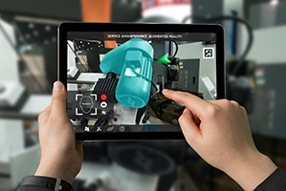
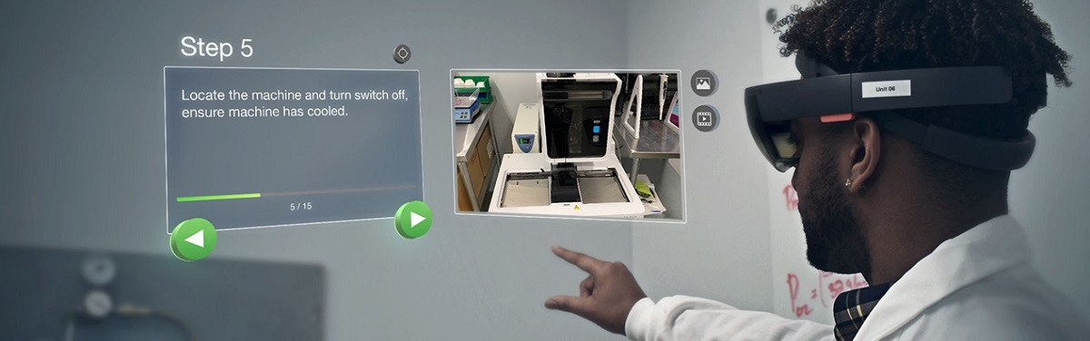
XR in Hybrid Work – Training
Immersive technologies help organizations train and upskill employees faster and safer.
Simulations and AR/MR applications allow employees to practice dangerous or difficult tasks in a safe environment.
Image Credits: PTC Vuforia

Slide 14
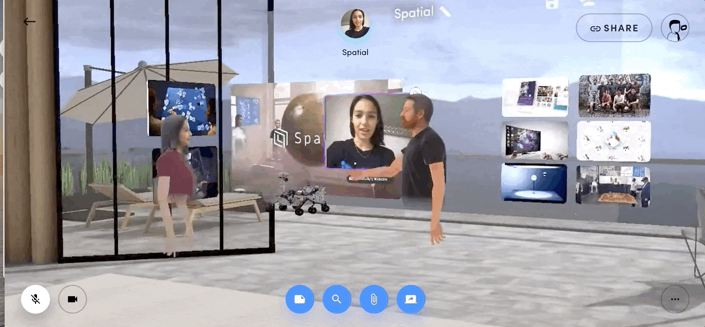
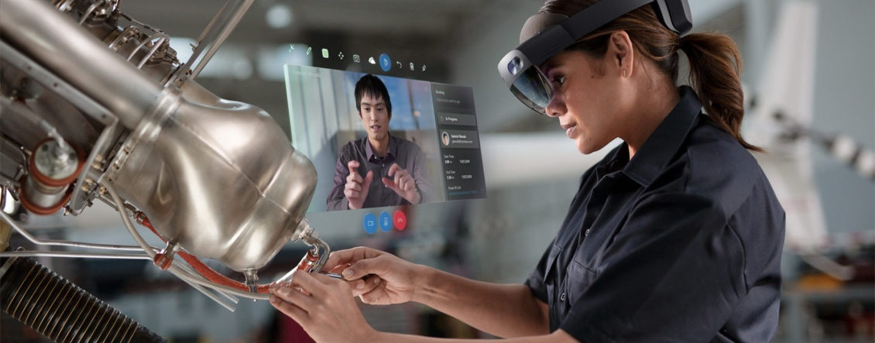
XR in Hybrid Work - Collaboration
Immersive technologies facilitate knowledge sharing among intergenerational coworkers.
The overlay of digital information onto physical environments helps employees in different locations collaborate in real time.
Image Credits: Spatial.io, Microsoft Hololens 2 & Dynamics 365

Slide 15

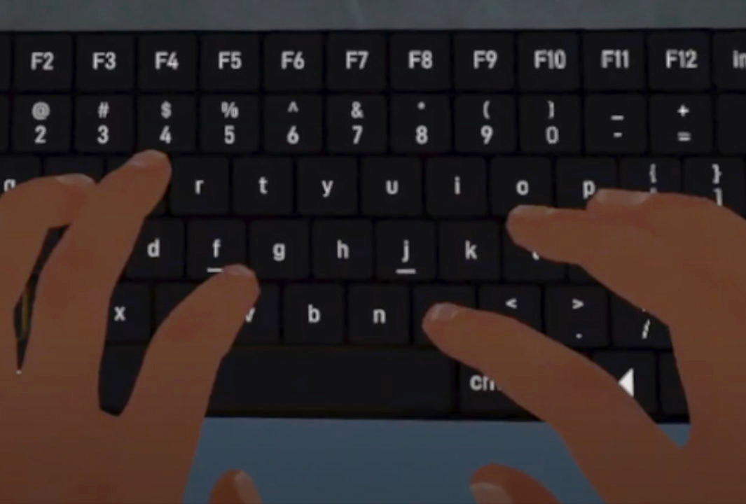
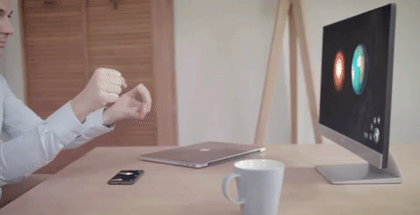
XR in Hybrid Work – Interactions
Personalized modes of interaction can increase accessibility and help ensure broad usability.
Different users benefit from the flexibility to choose options such as voice commands, eye-tracking, and gesture control.
Image Credits: Magic Leap, Immersed, ClayVR

Slide 16
Gaining a competitive edge with accessible immersive tech
Brave New World

Slide 17
Realizing Business Value
Prioritizing accessibility in XR and immersive tech adoption can give organizations a competitive edge in a tight labor market.
As organizations accelerate their digital transformations,
they can use XR to engage employees in new ways.
XR technologies enable businesses to attract and
hire more diverse talent pools.
XR has proven benefits that include improved
job training and enhanced collaboration.
To ensure people with disabilities can access these
benefits, XR tools must have accessibility features by design.

Slide 18


Inclusion Strengthens Businesses
Organizations that hire and retain people with disabilities earn 28% higher revenues, two times the net income, and 30% higher economic profit margins than their peers, according to Accenture.
Reference: Accenture in partnership with Disability:IN and the American Association of People with Disabilities (AAPD); “Getting to Equal: The Disability Inclusion Advantage,”

Slide 19

Accessible Tech Enables Everyone
The flexibility that comes with accessible XR technologies helps employees without disabilities as well. Usability features such as volume control, captioning, voice commands, and different ways to interact with a tool are just a few examples.

Slide 20
Community efforts to improve immersive tech accessibility
Brave New World

Slide 21

3 Viewpoints for XR Accessibility
Core XR HW and Platform SW (OS) Accessibility
  Making core XR hardware, platform software and embedded operating system-level apps accessible.
XR as Assistive Technology
  Using XR to build new kinds of assistive technologies, to improve access by people with disabilities.
Inclusive Design Aids XR Innovation
  Given immersive and XR tech involves wearable devices and spatialized interactions, designing for human diversity can aid in innovation and usability.

Slide 22

Community Efforts for XR Access
XR Access Initiative, a community of cross-sector participants from advocacy organizations, industry, and academia who are dedicated to ensuring XR is accessible to people with disabilities.
XR Association’s Developers Guide, Chapter 3: Accessibility & Inclusive Design in Immersive Experiences, provides software developers with best practices to make XR accessible to people of all disability types.
The Accessibility Playbook for Emerging Technology Initiatives, a blueprint from PEAT for launching a successful initiative to drive the development of accessible emerging technologies.
W3C XR Accessibility User Requirements help developers understand what people with disabilities may need when they access immersive applications and content.

Slide 23
How organizations can prepare
Brave New World

Slide 24

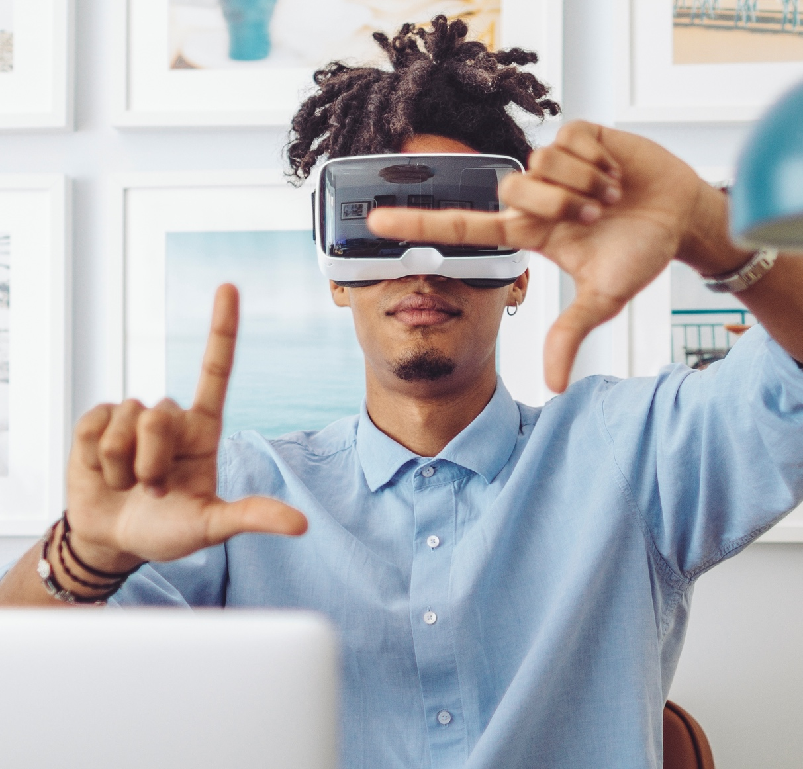
Take Action: Think & Consult
Think about how the technology will be used by employees with different sensory, physical, and cognitive needs, including those with temporary or situational limitations.
Consult Employee Resource Groups (ERGs) to learn employee perspectives and requirements. If ERGs do not exist in your org, start one…

Slide 25

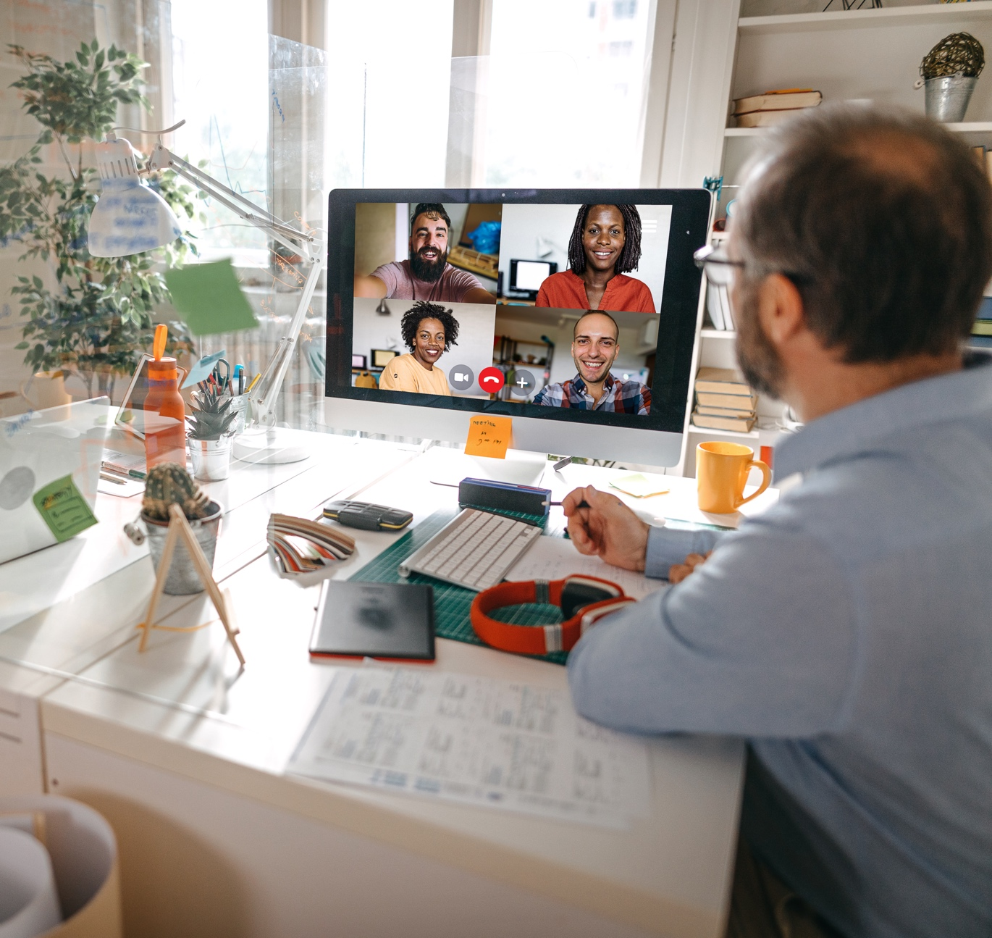
Take Action: Speak & Assess
Speak to suppliers to determine their accessibility testing protocols and learn whether people with disabilities were consulted in the design process.
Assess whether the technology is flexible and supports different input modalities, as well as interaction modes.
  For example, supporting different ways of communicating (voice, text, sign language) might help employees in loud or quiet environments.
Photo Credits: Cytonn Photography on Unsplash

Slide 26
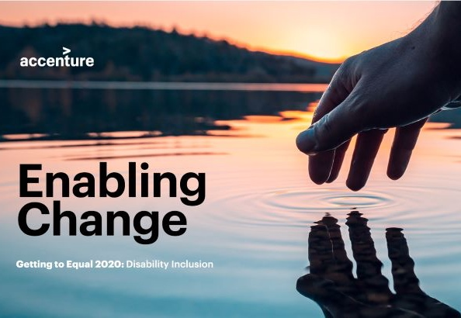
Take Action: Make a Business Case
Develop a business case for inclusive XR and immersive technologies that clearly maps to your established organizational goals and objectives.
Document how accessibility can support these goals.
Learn more:
  PEAT: Making the Business Case
  Accenture: “Enabling Change: Getting to Equal” Report

Slide 27
Resources and Q&A
Brave New World

Slide 28
Resources
XR Access Initiative (XRAccess.org)
XR Association Developers Guide, Chapter 3: “Accessibility & Inclusive Design in Immersive Experiences”
PEAT, “5 Takeaways from the XR Access Symposium Report”
PEAT / Workology Future of Work Podcast: “Value of VR for Training and Employee Development”
Download a newly-published White Paper, “Inclusive XR in the Workplace”, which PEAT has co-authored with the XR Association. Learn more at: PEATworks.org/ or XRA.org/

Slide 29
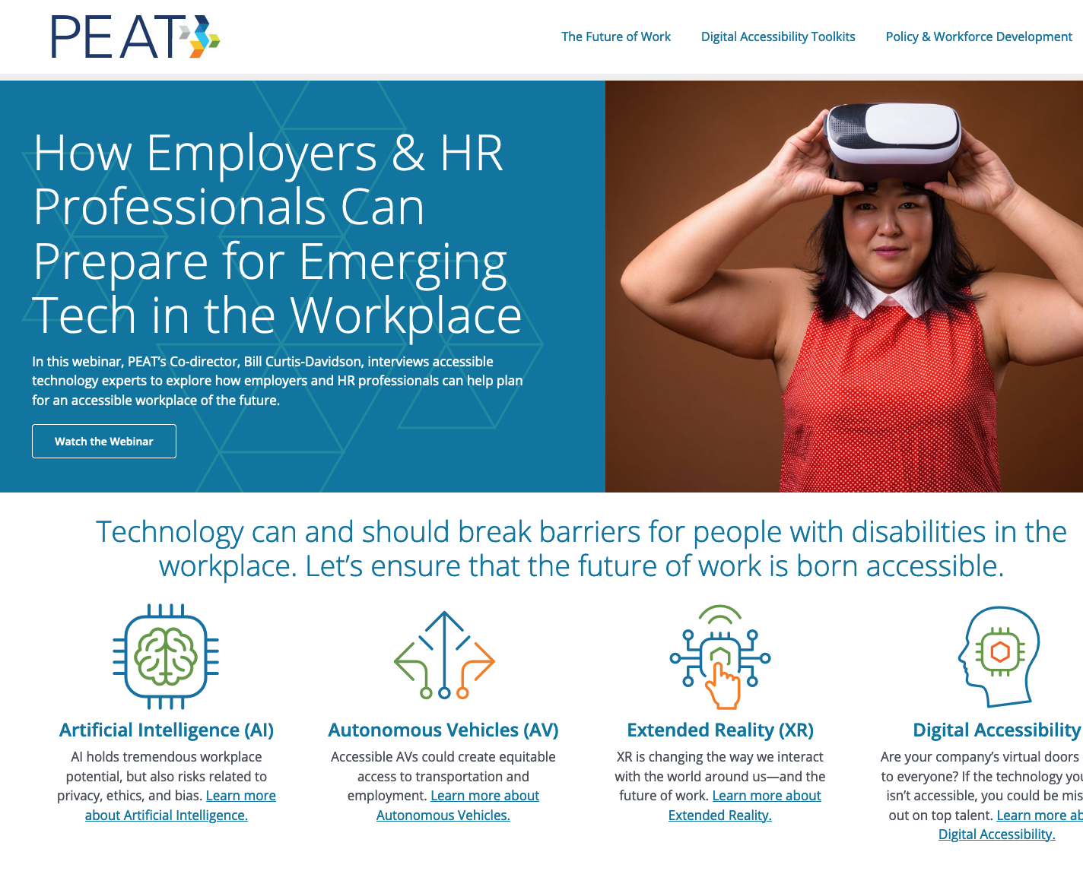

Join the Conversation
URL: PeatWorks.org
Newsletter: PeatWorks.org/eNews
Twitter: @PeatWorks
Email: hello@PeatWorks.org
    Bill Curtis-Davidson
    Co-Director, Partnership on Employment & Accessible Technology linkedin.com/in/billcurtisdavidson/

Slide 30
Thank You!
Brave New World: Accessible Immersive Technologies and the Future of Work

